Slide 1
A Dog’s Life
Proposal for Website

Slide 2
Site Map
Grooming Services
Map to Store
How to Select a Good Pet
Home Page
Contact Information

Slide 3

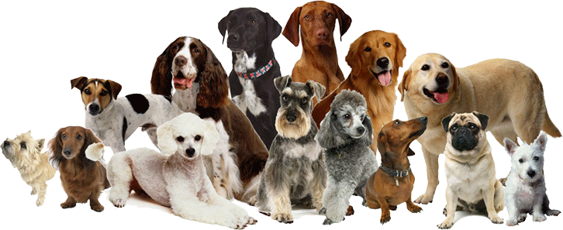
Home Page
Grooming Services
Map to Store
How to Select a Good Pet
Schedule an Appointment
prakashdoggrooming@gmail.com
602-123-4567

Slide 4
Grooming Services
Grooming Services
Map to Store
How to Select a Good Pet
ALL DOG GROOMS INCLUDE
Pre-groom consult, Bath, Blow-dry, Brush, Nail trim, Paw trim (feet and between pads), Breed appropriate clip, Scissor finish, Sanitary trim (if necessary), Scented finish (if requested), Parasite check, Gland expression (if necessary), Treat (with prior approval), and lots of love, affection and tenderness
ADD-ON SERVICES
CBD Treatment Hand Scissor Cut Teeth Brushing Blueberry Facial Anti-Anxiety Treatment De-Matting De-Shedding De-Skunking Flea/Tick Treatment Shave-Downs Skin Treatment* *100% natural aloe/tea-tree ointment

Slide 5
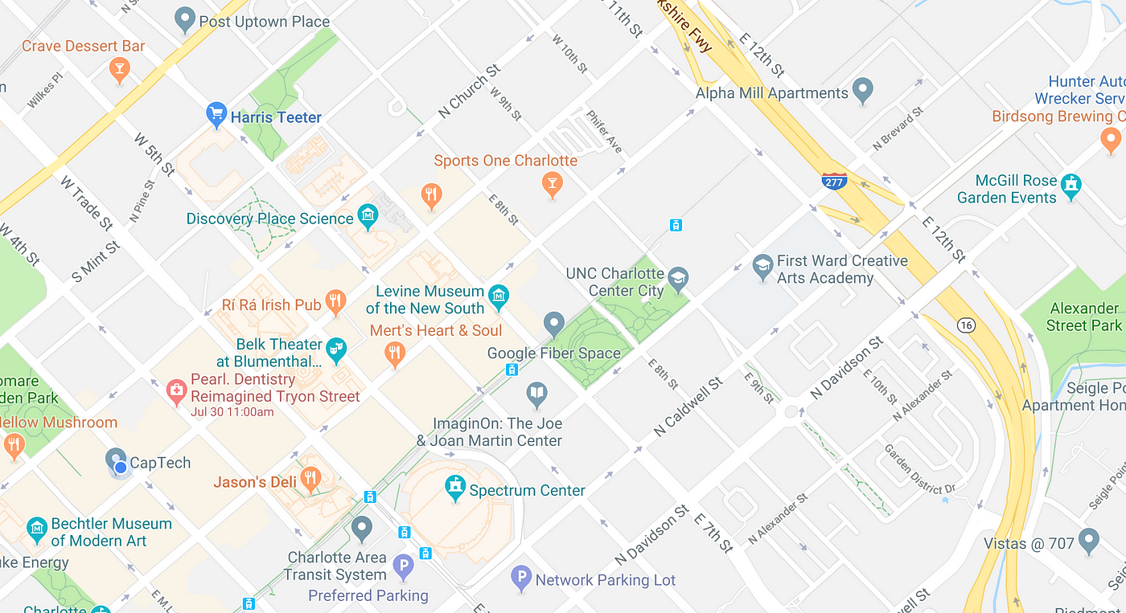
Map to Store
Grooming Services
Map to Store
How to Select a Good Pet
Schedule an Appointment
123 E Main St
Tempe, AZ 85288

Slide 6
Map to Store
Grooming Services
Map to Store
How to Select a Good Pet

